Slide 1
Module 7: Latest Emerging Technologies – Artificial Intelligence

Slide 2
Artificial Intelligence (AI)
Computers to perform tasks that required human intelligence (mimic human behaviour)
Machine Learning (ML)
Computers to learn from examples (mimic human learning)
Deep Learning (DL)
Neural Network (neurons, layers and interconnectivity) to tackle the complex tasks (mimic the human brain)
1950
1990
2010

Slide 3
Machine Learning Basics
Supervised, Unsupervised, Reinforcement learning
Neural Network
Simple neural network model
Multiple-layer (deep) neural network model
Applications
Different Deep neural network – and their application – some examples given in the Lecture slides
Main Challenges in AI
Limitation/concerns of AI and Solution

Slide 4
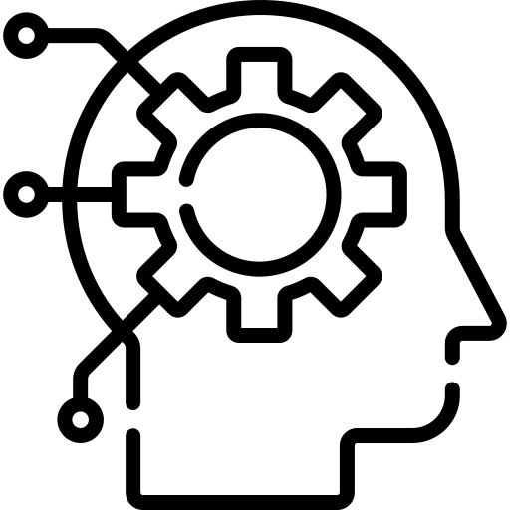
Machine Learning Basics
Supervised
Unsupervised
Reinforcement
Machine learning
Input Data
Machine Learning Model
Response

Slide 5
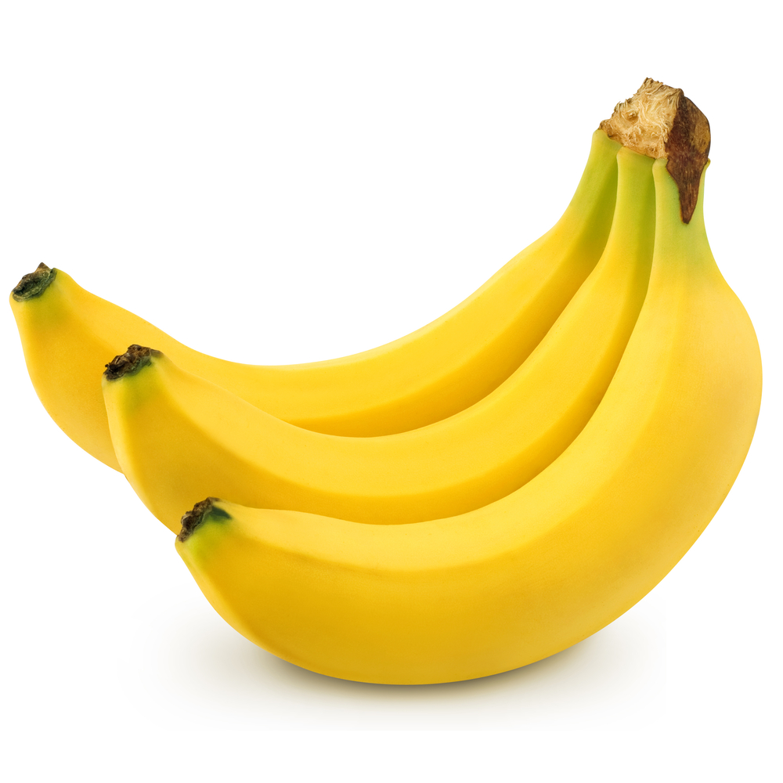
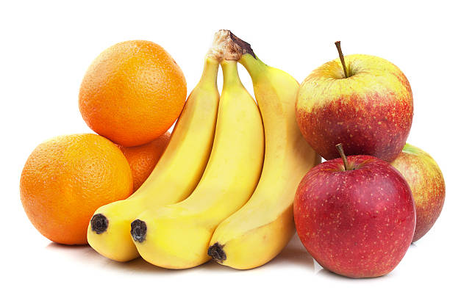
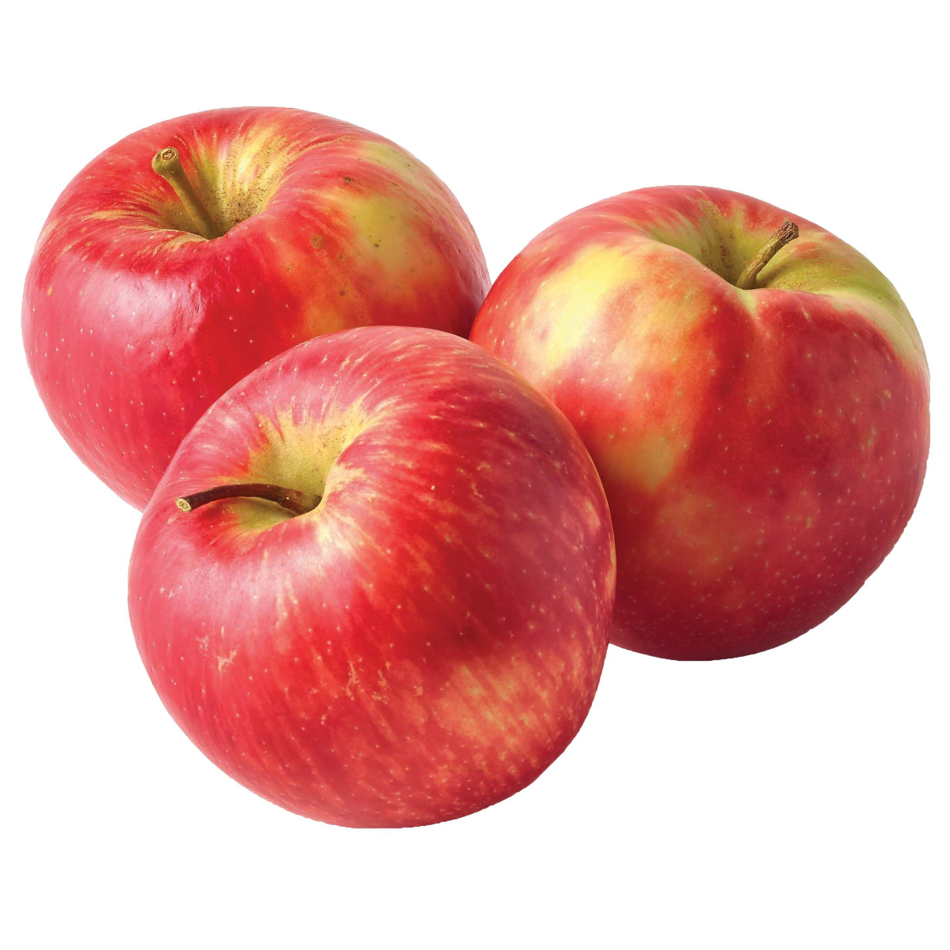
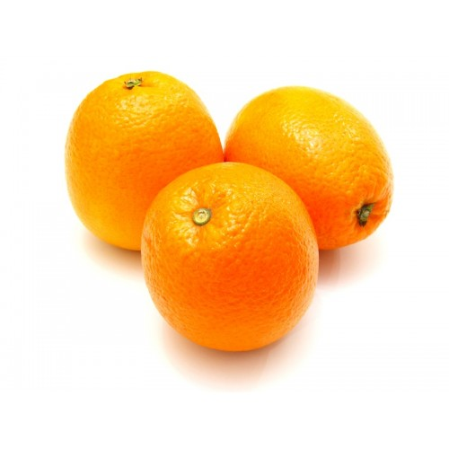
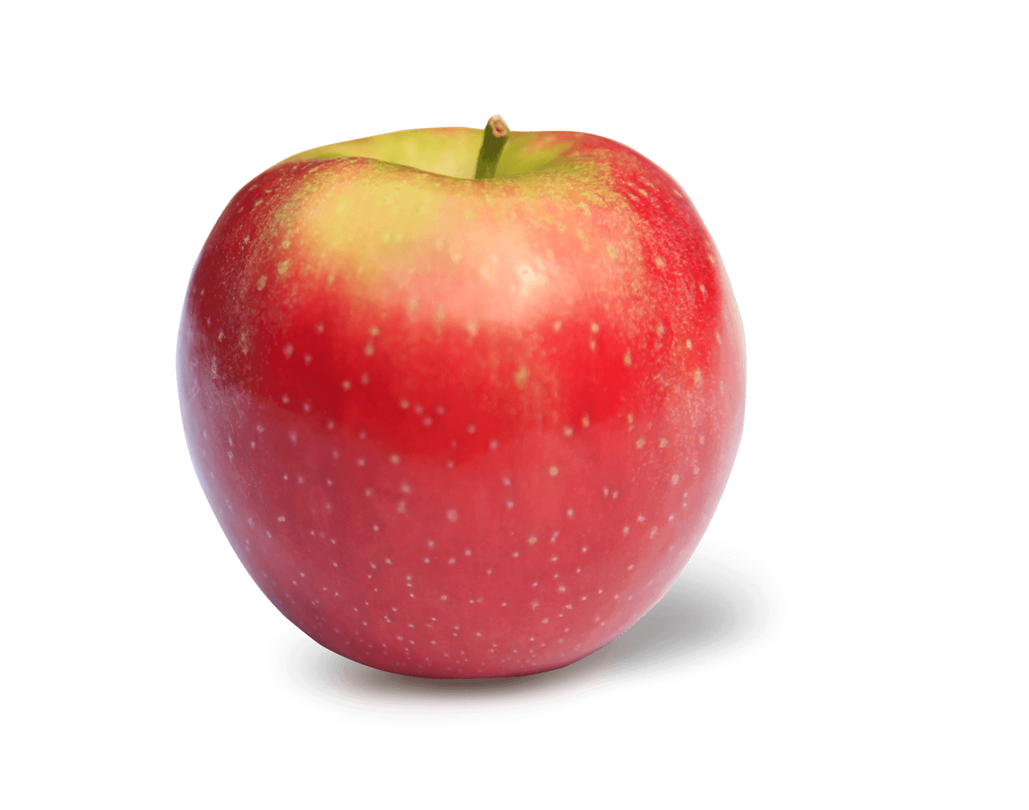
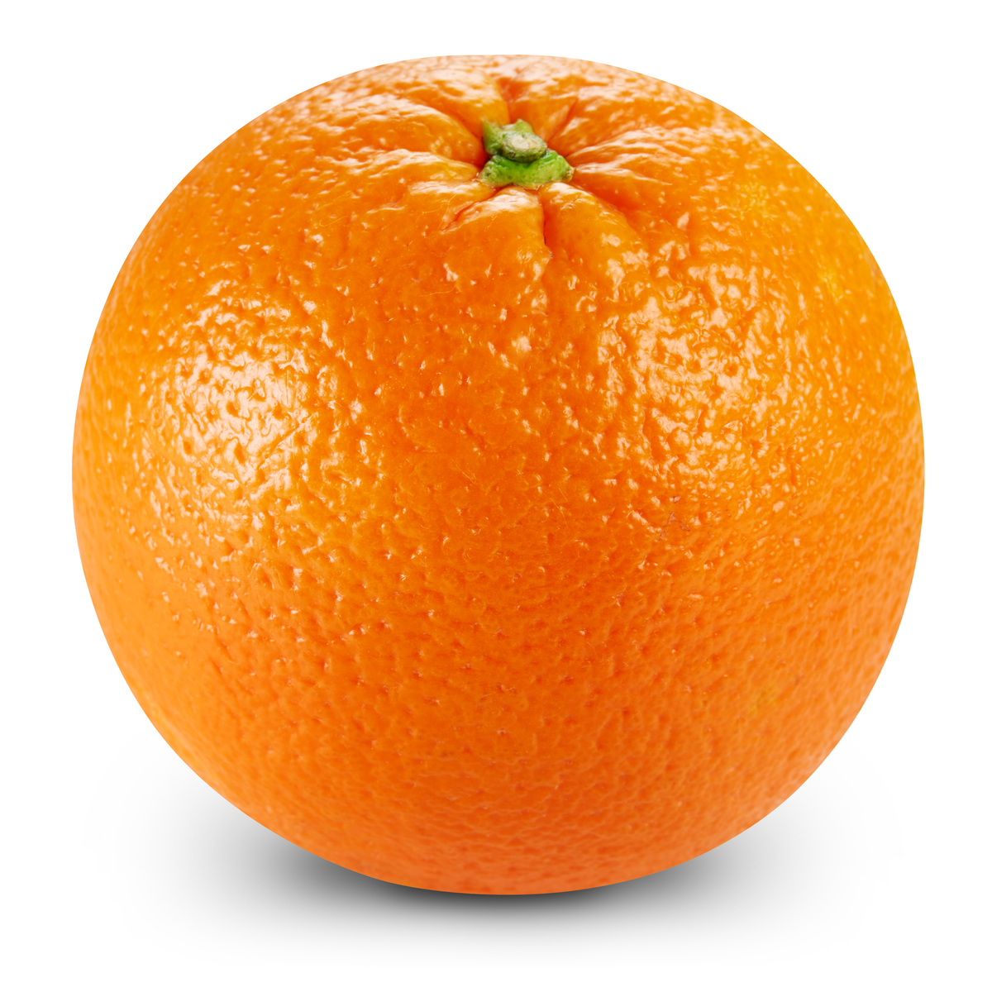

Class 1
Input Data
Machine Learning Model
Class 2
Class 3
Orange
Apple
Banana
Supervised Learning
Machine learning model learns under supervision
Model is able to categorize the input data (fruits) with the help of annotations or labelled data
Annotations
Notes:
This known data is fed to the machine, which analyses and learns the association of these inputs based on its features such as shape, size, colours, contours etc.

Slide 6
Class 1
Input Data
Machine Learning Model
Class 2
Class 3
Orange
Apple
New Data
Banana
Supervised Learning
Machine learning model learns under supervision
Model is able to categorize the input data (fruits) with the help of annotations or labelled data
Annotations
Notes:
Now when a new input (fruit) is fed to the machine without any label, the machine is able to (should be able to) predict accurately its class with the help of the past data (learning/training).

Slide 7
Discuss on Unsupervised and Reinforcement Learning

Slide 8
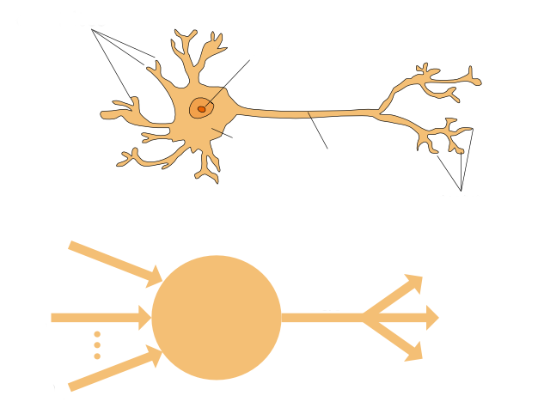
Neural Network - a commonly used model in machine learning
Dendrites
Nucleus
Original Neuron
Input
Signals
Cell
body
Axon
Axon
terminals
In₁
Artificial Neuron – called Perceptron
In₂
Σ
ƒ
Out
In_{n}
Bias

Slide 9
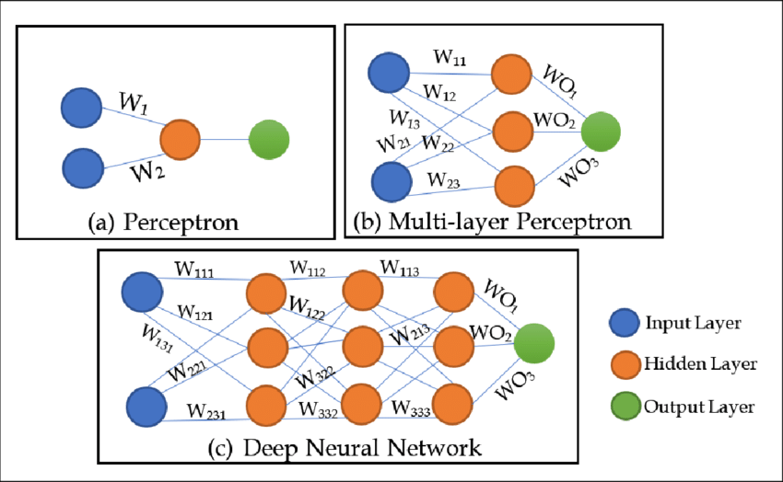
Perceptron – Multi-layer Perceptron (MLP) – Deep Neural Network (DNN)
Multi-layer perceptron consists of at least one hidden layer.
Notes:
Although the perceptron can be very useful in performing classification tasks, more often, perceptrons are stacked resulting in a multi-layer network.
Formally defined, a multi-layer perceptron consists of more than one layer of perceptron.
<<CLICK>>
In the example shown below, we have a multi-layer perceptron consisting of five layers.
Firstly, we have an input layer denoted by the red boxes.
These input may consist of numerical values corresponding to text data, images, or even videos.
These data will propagate through different ‘hidden’ layers shown in dark blue coloured nodes before reaching the output layer.
In an actual application, the number of hidden layers may be much more complicated and requires higher computational processes.
In those scenarios, advanced methods such as node dropout may be used to prevent overfitting which we will not discuss in this module.

Slide 10
Artificial Neural Network (ANN) – Multi-layer Perceptron (MLP)
Multi-layer perceptron consists of at least one hidden layer.
A five-layer network:
Output
Input
Input Layer
First Hidden Layer
Second Hidden Layer
Third Hidden Layer
Output Layer
Notes:
Although the perceptron can be very useful in performing classification tasks, more often, perceptrons are stacked resulting in a multi-layer network.
Formally defined, a multi-layer perceptron consists of more than one layer of perceptron.
<<CLICK>>
In the example shown below, we have a multi-layer perceptron consisting of five layers.
Firstly, we have an input layer denoted by the red boxes.
These input may consist of numerical values corresponding to text data, images, or even videos.
These data will propagate through different ‘hidden’ layers shown in dark blue coloured nodes before reaching the output layer.
In an actual application, the number of hidden layers may be much more complicated and requires higher computational processes.
In those scenarios, advanced methods such as node dropout may be used to prevent overfitting which we will not discuss in this module.

Slide 11
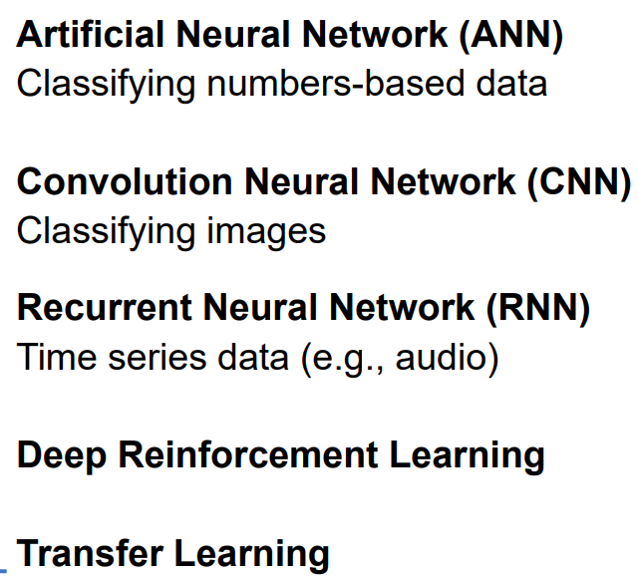
Few different Deep Learning Models available

Slide 12
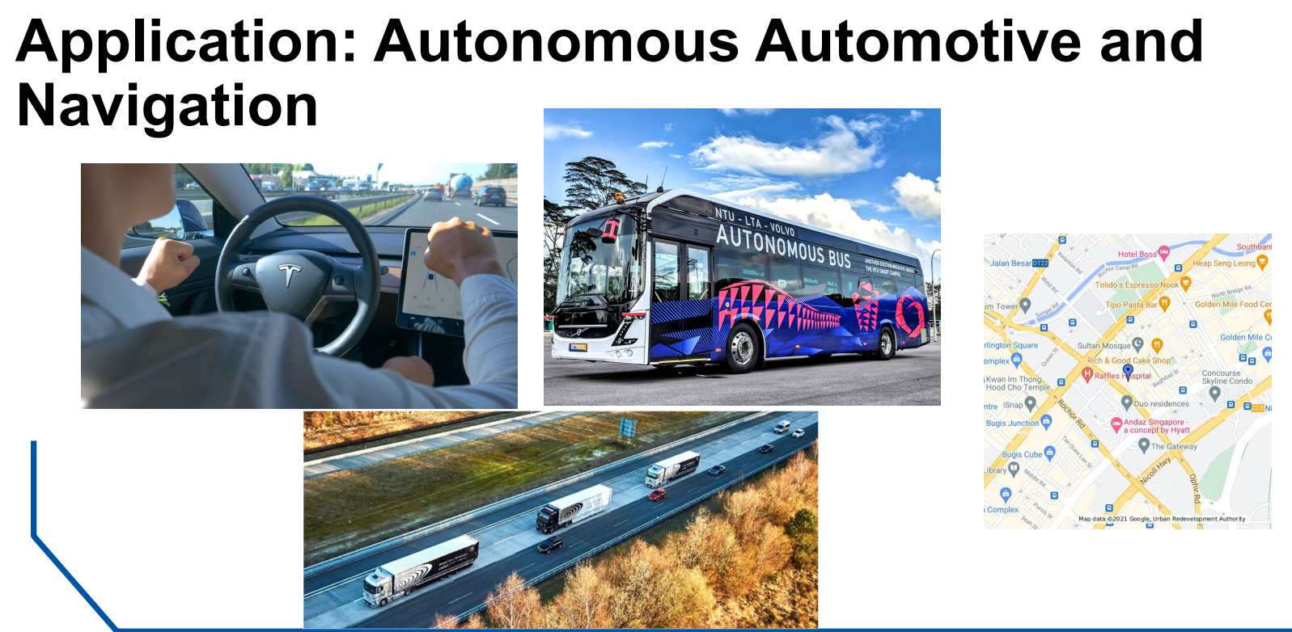

Slide 13
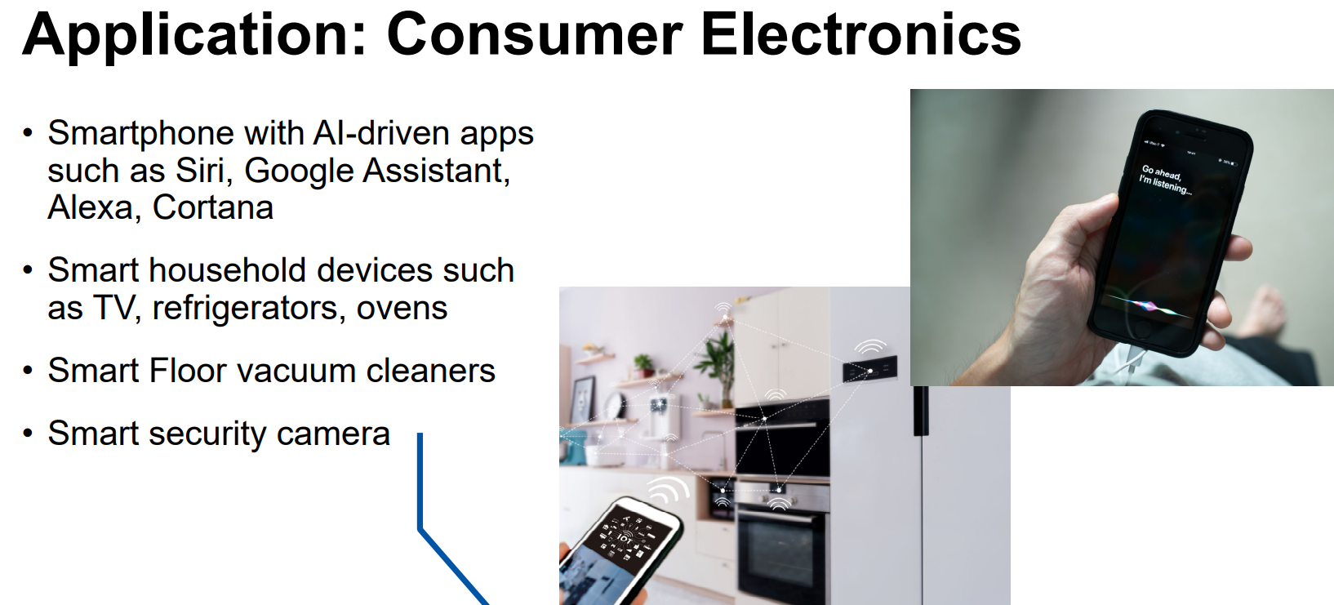

Slide 14
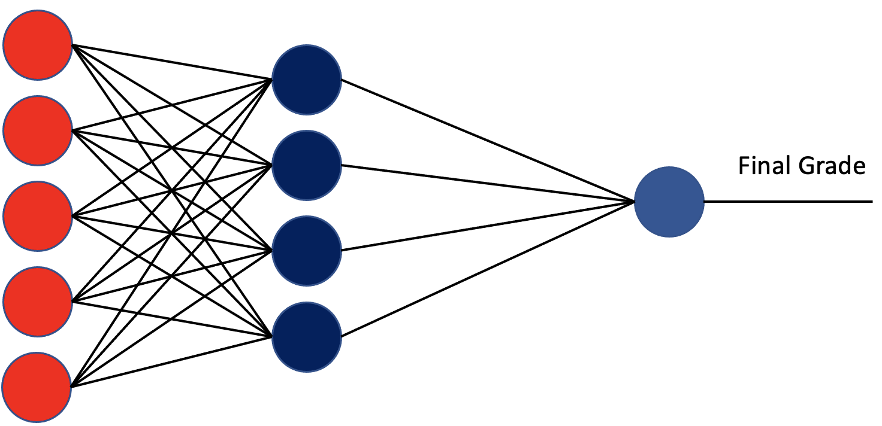
AI application to Healthcare: Example: COVID cases prediction
Actual COVID positive cases per day
Training Phase
S
COVID Data
Prior day COVID positive cases
Weather condition information
Vaccination status
Past Medical condition information
Model training
+
-
Pre-processing and feature extraction
+
Predicted COVID positive cases per day
Error
Goal: To minimise error loss during the training phase
Save trained weights
Deployment Phase
Pre-processing and feature extraction
New
COVID positive case Data
Trained model
Predicted COVID positive cases
Use trained weights for COVID positive cases prediction

Slide 15
AI New Innovation: Generative AI based - ChatGPT
Generative artificial intelligence (also generative AI or GenAI) - used to generate new text, images, videos, sounds, code or other media based on our prompts.
There are several generative AI platforms you can become familiar with, and you may find them helpful for automating certain processes in your workflow.
ChatGPT: his language model has a foundation of GPT architecture that generates text that resembles something a human would produce. It's a helpful companion for research, strategy, and content creation.
DALL-E2: This model generates images from text prompts, so creatives can create vibrant illustrations and concept art that’s a useful accompaniment to content marketing.
GitHub Copilot: This collaboration between GitHub and OpenAI acts as a coding companion to help developers code faster and more intuitively.

Slide 16
Tutorial 6: Design and Solve 3D Maze with GenAI
In the tutorial activities, your group will design a complex 3D maze using GenAI and then solve it. Your group MUST seek GenAI support in completing all the activities.
This week, groups will engage in immersive and hands-on activities regarding how to effectively collaborate with GenAI to:
Design a 3D maze that meets the following requirements:
The width and the length of the maze should be at least 10 units.
The maze should contain all environmental assets (green tree, cherry blossom, rock, block A, block B, river, bridge)
Try your best to make the maze challenging but engaging.
Optional: the maze can contain two gems (gems need to be collectible in maze solving)
After finishing the maze creation, each group will need to solve their own maze using GenAI.
At the end of the assignment, students will learn the fundamentals of prompt engineering, the strengths, and weaknesses of GenAI, and be able to critically evaluate the accuracy of GenAI’s outputs.

Slide 17
Challenges in AI – “Black Box Nature”
Machine Learning Models
(Example: Support Vector Machines, Random Forest, Neural Networks)
Input X
How do we know if the output is accurate?
Do we understand how the outcomes are being derived?
Can we justify the predicted outcome?
Input Y
Output S
Input Z

Slide 18
Generative AI based –Concerns
Generative AI’s popularity is accompanied by following concerns,
Ethics, misuse, and quality control. Because it is trained on existing sources, including those that are unverified on the internet, generative AI can provide misleading, inaccurate, and fake information.
Even when a source is provided, that source might have incorrect information or may be falsely linked.
Falsified information can make it easier to impersonate people for cyber-attacks.
So, what could be the solutions to these concerns? Any thoughts?

